Slide 1




LENDI INSTITUTE OF ENGINEERING AND TECHNOLGOY
(Autonomous)
Approved by AICTE and Permanently affiliated to JNTU Gurajada-Vizianagaram.
ECE,EEE,CSE&MECH
DEPARTMENT OF COMPUTER SCIENCE AND ENGINEERING
NAME OF THE SUBJECT : Java Programming
NAME OF THE TOPIC :Introduction to Java
PRESENTED BY :
Mr. T.Thirupatirao
Assistant Professor

Slide 2
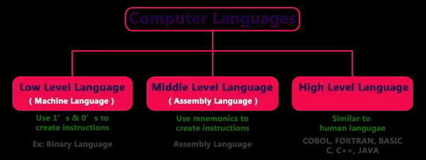
Computer languages

Slide 3
Oops(object oriented programming system)
Class
Object
Polymorphism
Inheritance
Abstraction
Encapsulation

Slide 4
Books & References
The complete Reference Java, 8th edition, Herbert Schildt, TMH.
Programming in JAVA, Sachin Malhotra, SaurabhChoudary, Oxford.
Introduction to java programming, 7th edition by Y Daniel Liang, Pearson.
Java: How to Program, 9th Edition (Deitel) 9th Edition.
Core Java: An Integrated Approach, Java 8 by R. Nageswara Rao.

Slide 5
Some Basics
Q. What is a program?
Ans. A sequence of instructions that a computer can interpret and execute.
Q. Why Java and not Telugu/Hindi/ English?
Ans. Since, so far, computer is not intelligent enough to understand natural languages.

Slide 6
Structure of Java Programs
class class-name {
public static void main(String args[]) {
statement1;
statement2;
…
…
}
}

Slide 7
Example Program
“First.java”
class First {
public static void main(String args[]) {
System.out.println(“Hello World”);
}
}

Slide 8
Compiling & Running the Program
Compiling: is the process of translating source code written in a particular programming language into computer-readable machine code that can be executed.
javac First.java
This command will produce a file ‘First.class’, which is used for running the program with the command ‘java’.
Running: is the process of executing program on a computer.
java First

